Slide 1


Slide 2

WEB SCRAPPING AND EXPLORATORY DATA ANALYSIS ON AIR CONDITIONERS
- Ab har wish hogi poori…

Slide 3
About me
NAME:- Musku Ragavendar Reddy
QUALIFICATION:- BBA(Finance)
WHY DO I WANT TO LEARN DATA SCIENCE?
I had Business Analytics in my Under Graduation, which grabbed my interest at a first glance. So It made me build my career in the field of analytics to grow to great heights as an individual.
WORK EXPERIENCE?
I’m a Fresher.

Slide 4
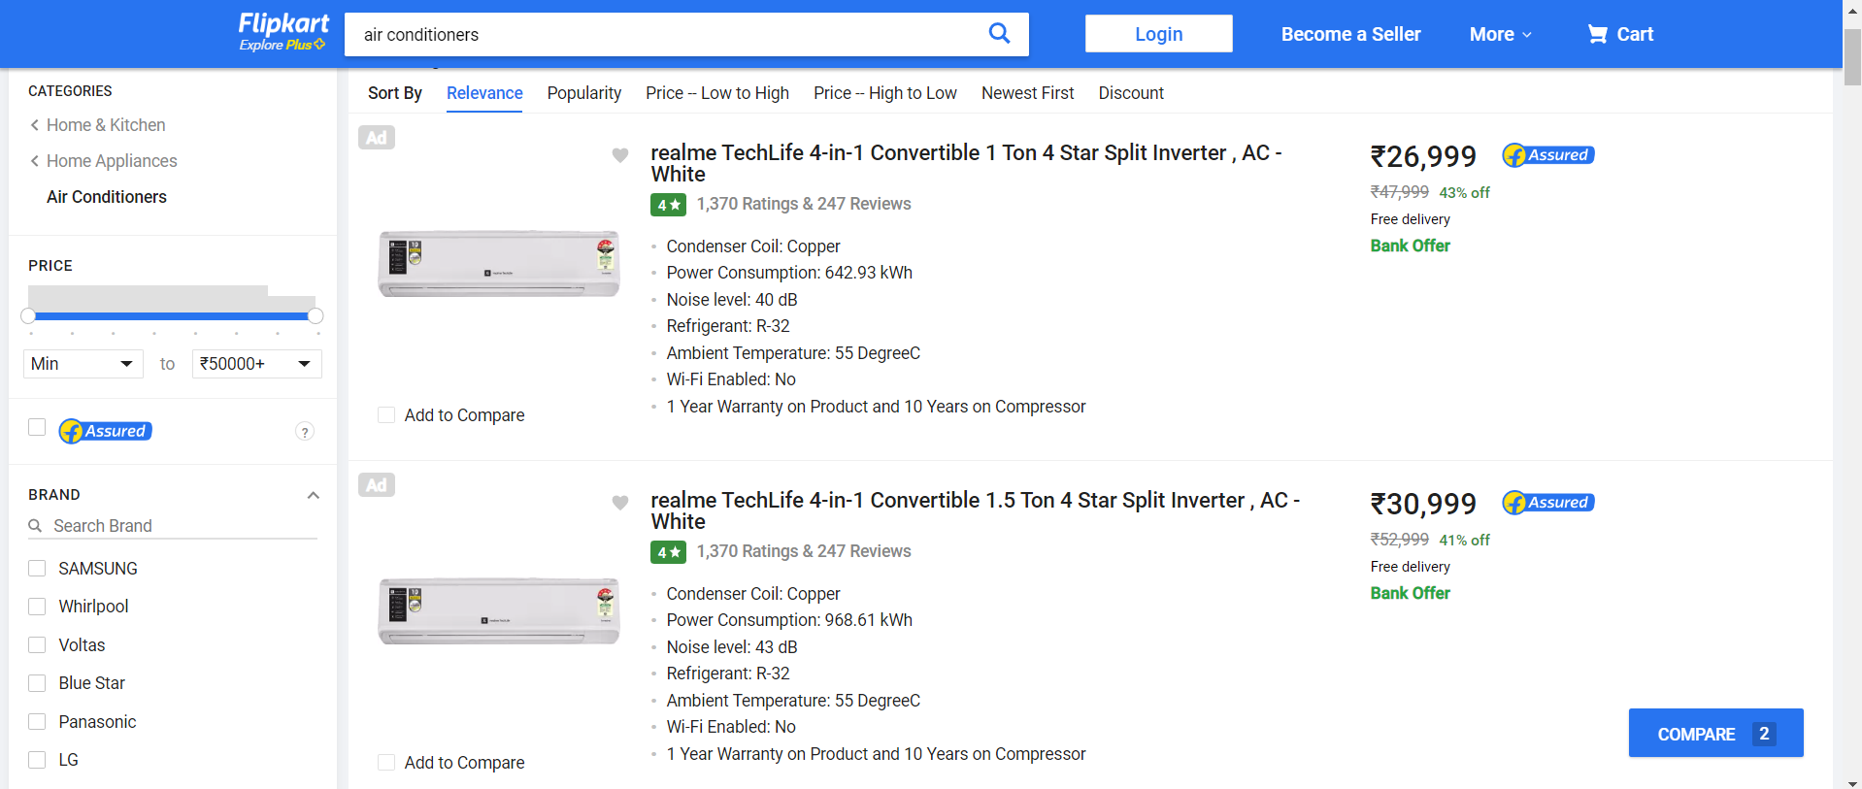
WEBSITE: https://www.www.flipkart.com/search?q=ac&otracker=search&otracker1=search&marketplace=FLIPKART&as-show=on&as=off&page=.com

Slide 5
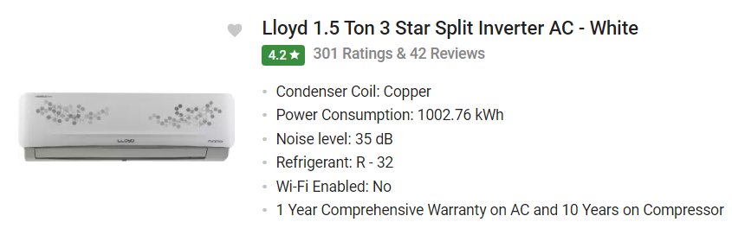
FEATURES:
1 . BRAND
2 . CAPACITY
3 . RATING
4 . CONDENSER COIL
5 . POWER CONSUMPTION
6 . NOISE LEVEL
7 . WI-FI
8. WARRANTY
9 . PRICE

Slide 6
IMPORTING THE LIBRARIES
Libraries:
Numpy
Pandas
Matplotlib
Seaborn
Requests
Bs 4/ Beautiful Soup
Re

Slide 7
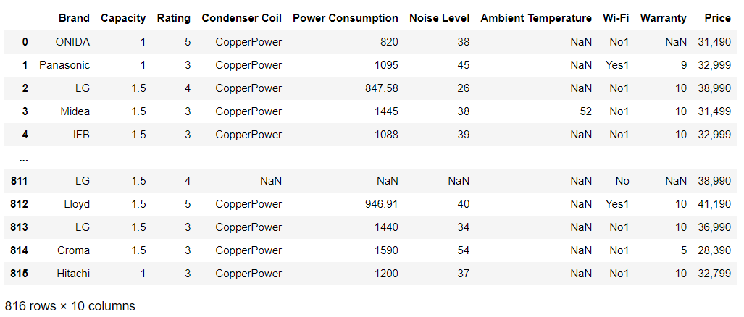
CREATION OF DATAFRAME

Slide 8
DATA CLEANING :
Identifying Null Values.
Identifying Missing Values.
Removing special characters.
Removing unwanted columns and rows. For Example, Index, unnamed-0, etc...
Treating columns and converting required columns from object to int or float datatype.

Slide 9
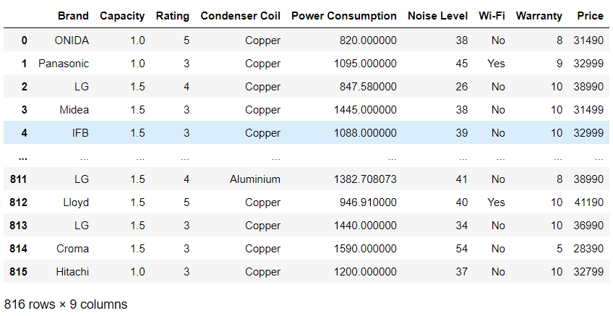
DATAFRAME AFTER CLEANING

Slide 10
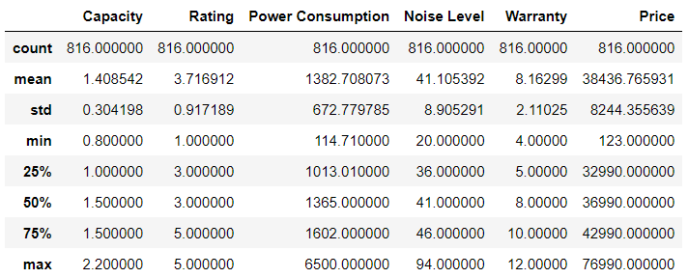
Summary Statistics of the Dataframe

Slide 11

VISUALIZATION :

Slide 12
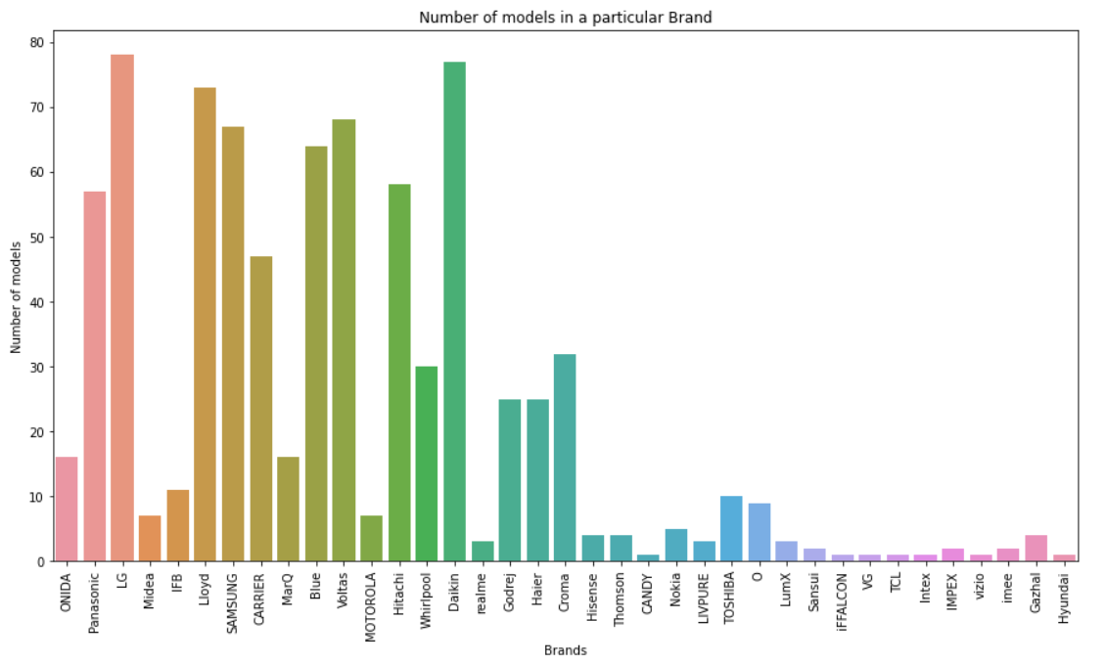
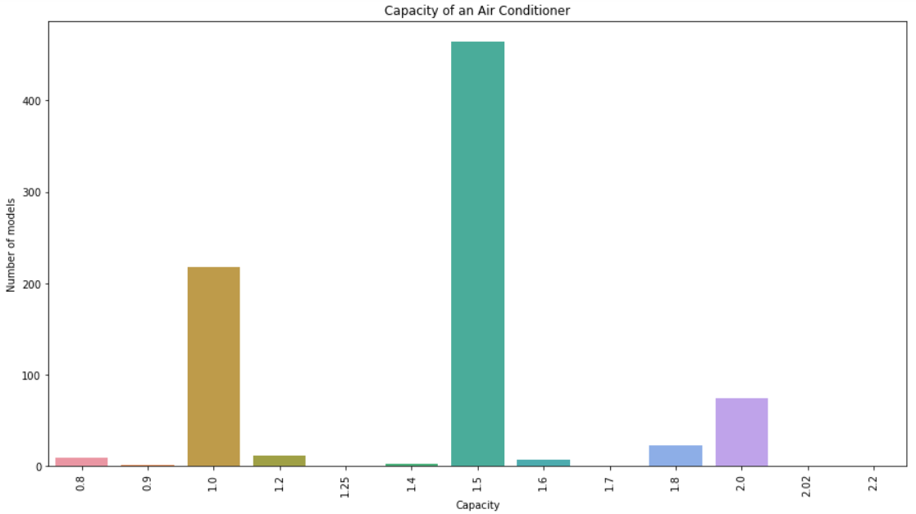
Brand vs Models and Capacity vs Models
There are more 1.5 Ton and 1.0 Ton variants as compared to others.
LG has the highest number of models. Whereas, VG, Intex, TCL, CANDY, and Vizio have the least.

Slide 13
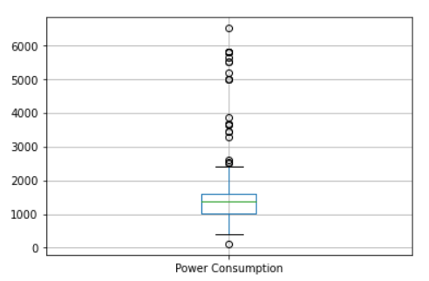
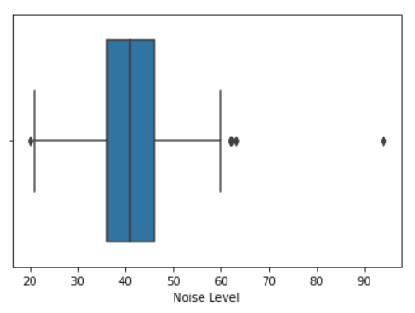
POWER CONSUMPTION vs NOISE LEVEL
The normal range of power consumption is from 1000 W to 1600W. And here, the median is 1365 Watt. There are many outliers beyond 2500 W.
The inter-quartile range of Noise level is between 21 dB to 60 dB. We can observe that the minimum level is 20 dB and the maximum level is 94 dB. Here, the median is 41 dB.

Slide 14
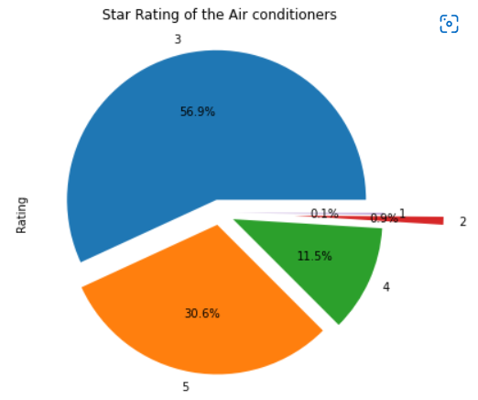
56.9% of the Air conditioners have the rating "3" out of 5, which is moderate. And "4" & "5" rated Air conditioners together are 42.1%, which is good enough. only 1% of Air conditioners are rated the least.

Slide 15
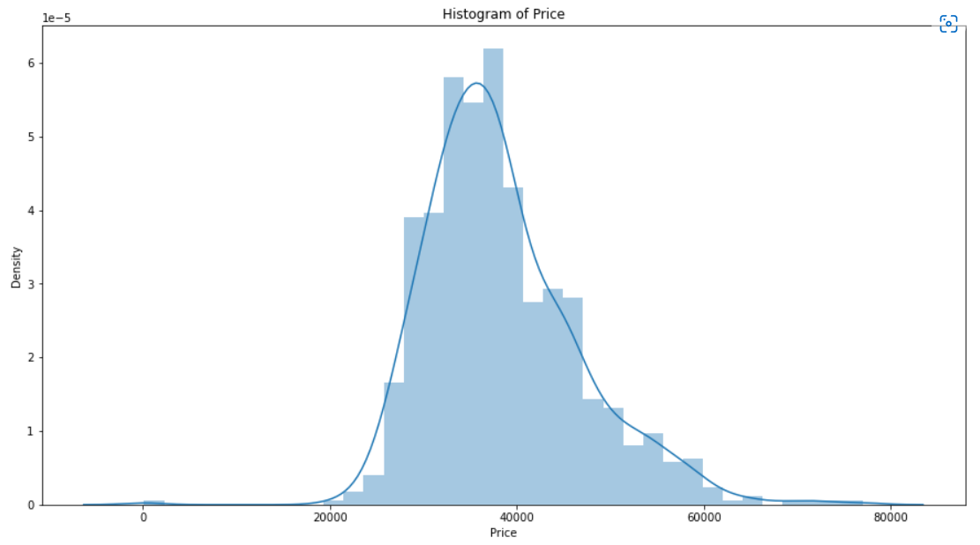
Many of the Air conditioners are available in the price range between RS.30,000 to RS.40,000. Price Starts from 22,000 and goes up to 77,000.

Slide 16
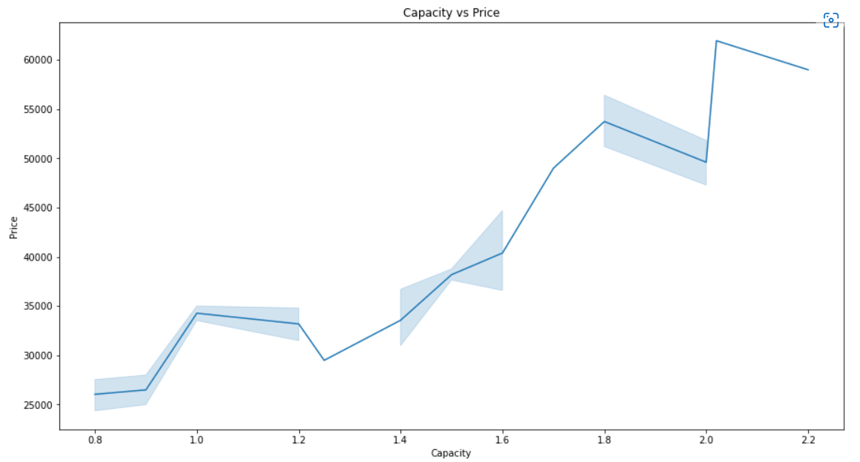
As the Capacity increases, the Price is also increasing. So, We can conclude that the price of an Air conditioner is directly proportional to its capacity.

Slide 17
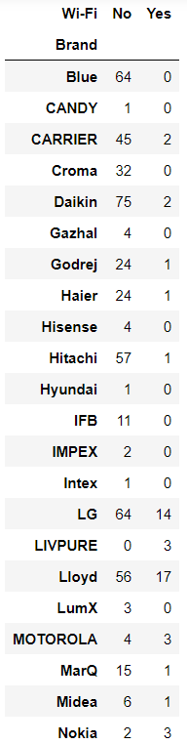
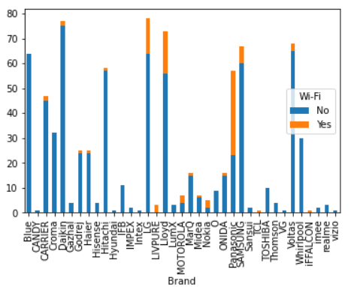
This is the Bar chart visualization of the Wi-Fi feature availability of all the Brands. We can conclude that there are many models with Wi-Fi features in Panasonic followed by Lloyd & LG. Whereas, IFB, Toshiba, and Blue Star didn't have any models with Wi-Fi features.

Slide 18
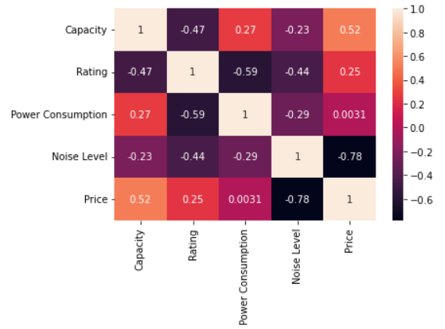
There is a negative correlation between Noise Level and Price [-0.78] and there is a positive correlation between Power Consumption and Capacity [0.27].

